Slide 1




Slide 2

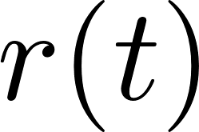
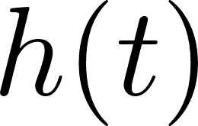

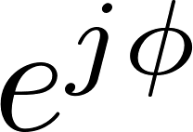

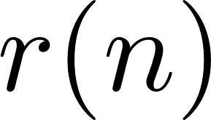
iNET
Packetizer
SOQPSK-TG
Modulator
Channel
Data Bits
Down-Convert &
Filter
Resample
RF
IF
ADC
Received Signal

Slide 3



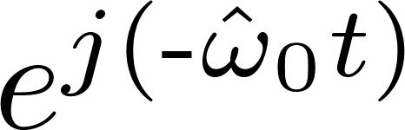
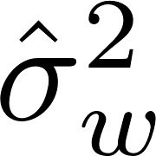


Preamble
Detector
Frequency
Offset
Estimator
Estimators
Equalizer
(Filter)
Detection
Filter
OQPSK
Detector
2

Slide 4




Slide 5
T/M Receiver & Demod
RF
70 MHz IF
Samples
Bits
T/M Receiver
ADC
Host CPU
Host CPU
FPGA
FPGA
BERT
K40c GPU
K20c GPU
K20c GPU
Rack Mounted Server
Rack Mount Case

Slide 6
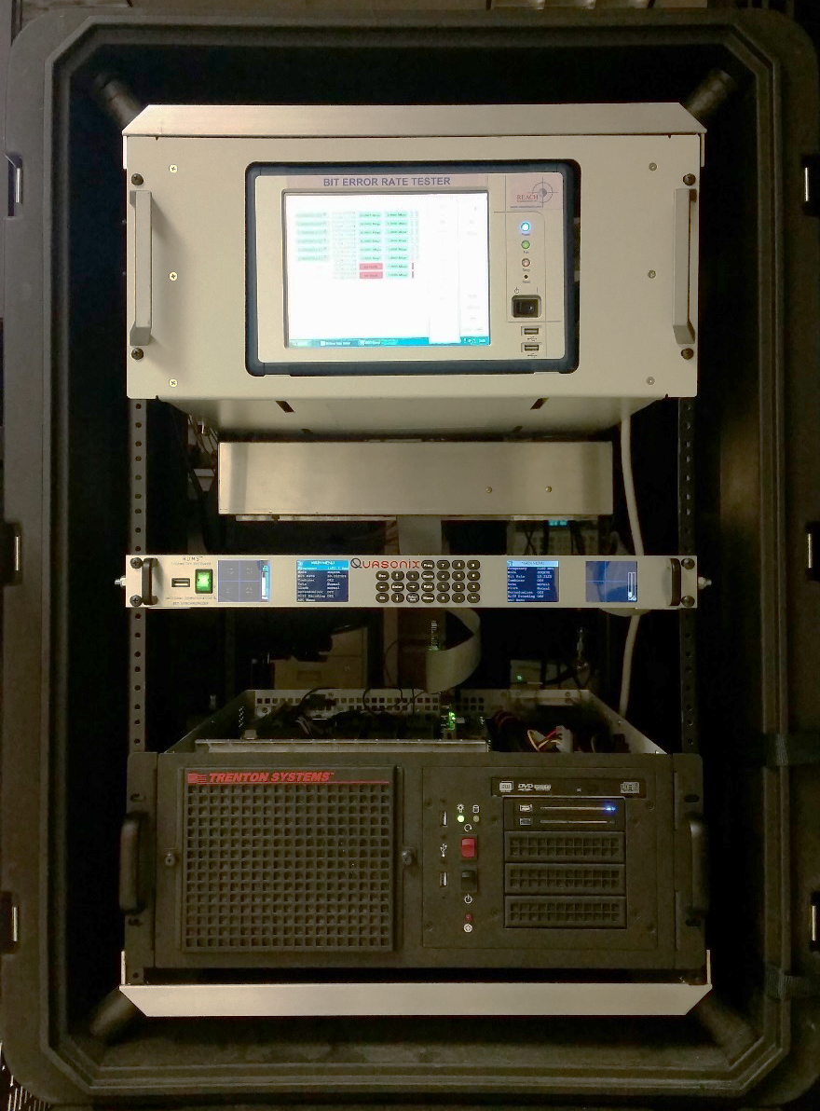
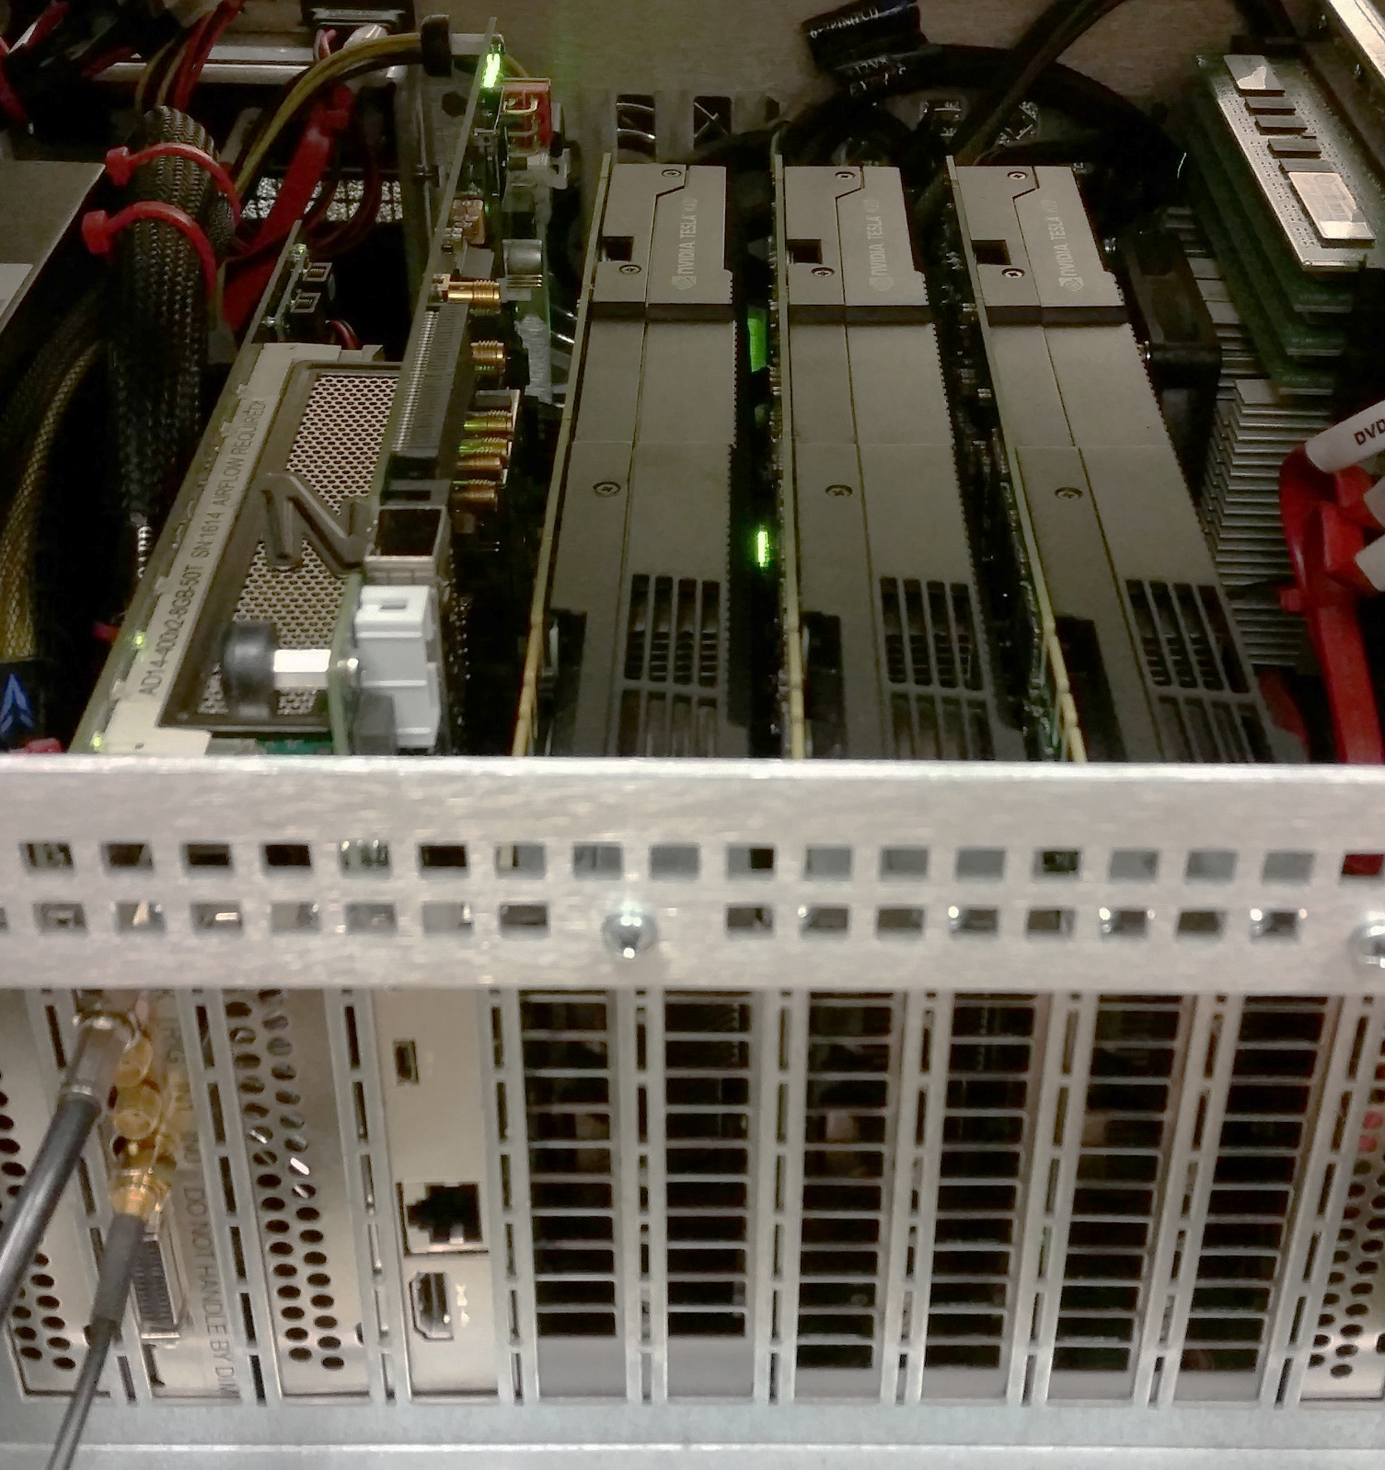
Host
CPU
BERT
T/M Receiver
Rack Mounted
Server
Rack Mount
Case
ADC
FPGA
K40c
GPU
K20c
GPU
K20c
GPU

Slide 7
128
bits
64
bits
6144
bits
Preamble
ASM
Data
6336 bits
Data
Preamble
ASM
Data
Preamble
ASM
Data

Slide 8












Compute ZF
Filter
Apply Filters
OQPSK
Detector
2
Compute MMSE
Filter
Apply Filters
OQPSK
Detector
2
Compute CMA
Filter
Apply Filters
OQPSK
Detector
2
Compute FDE1
Apply Filters
OQPSK
Detector
2
Compute FDE2
Apply Filters
OQPSK
Detector
2

